Slide 1
Software Engineering Review-2
Peer-to-peer Book Rental Service

Slide 2
Work Breakdown Structure

Slide 3
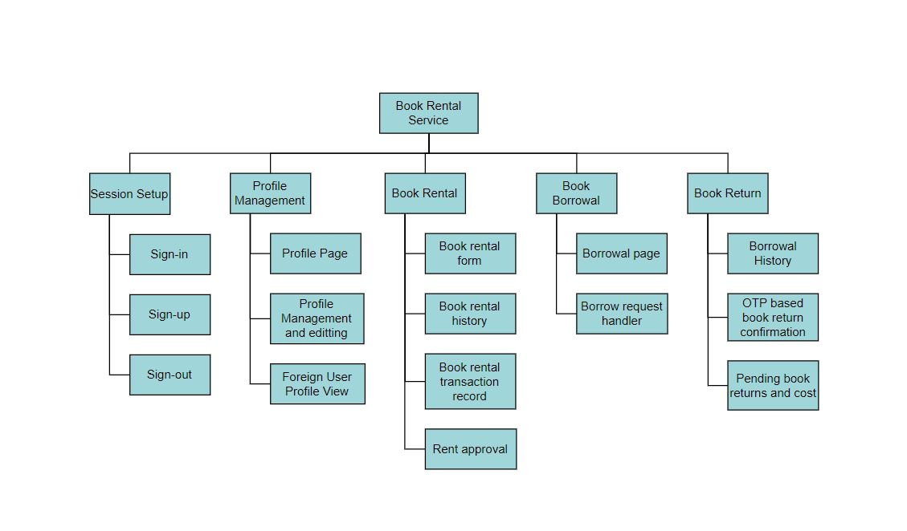
Deliverable-based WBS

Slide 4
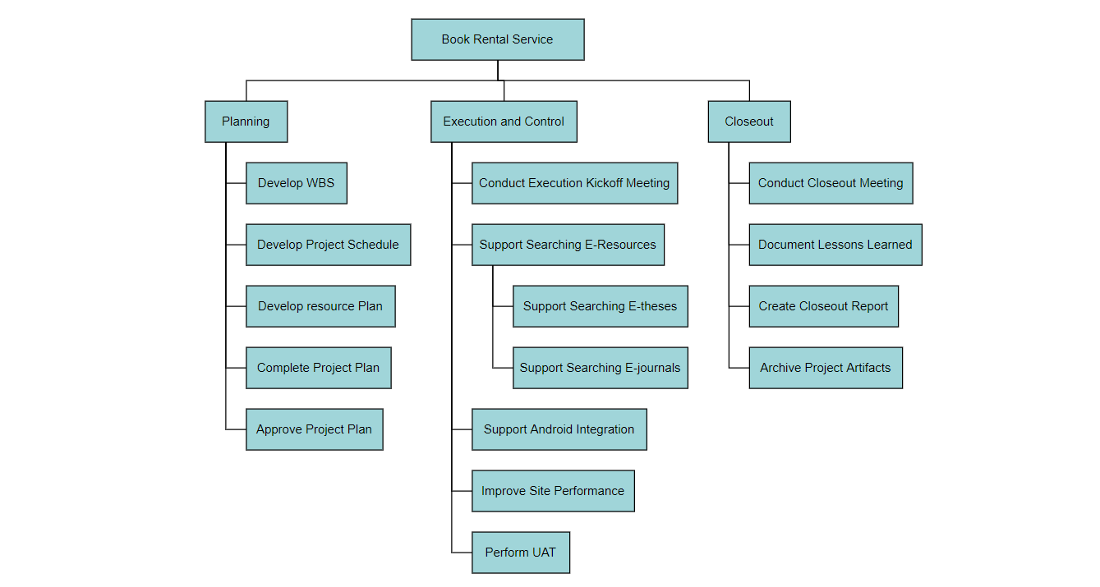
Phase-based WBS

Slide 5
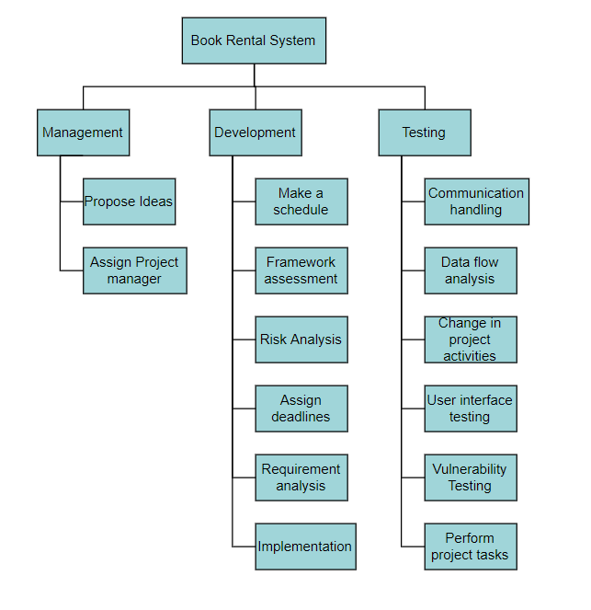
Responsibility-based WBS

Slide 6
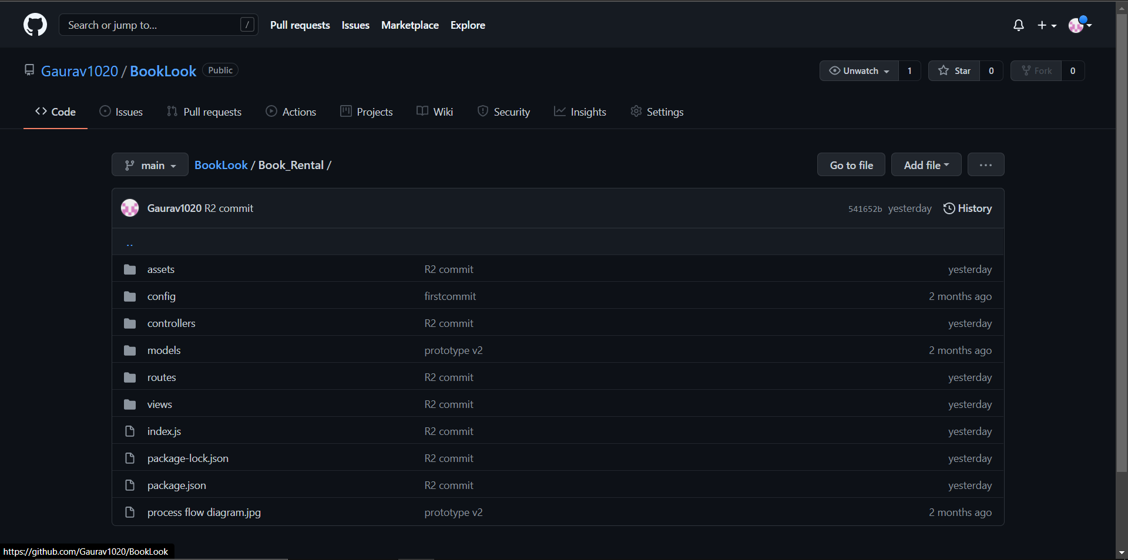
Code
Link:- https://github.com/Gaurav1020/BookLook

Slide 7
Summary

